Slide 1
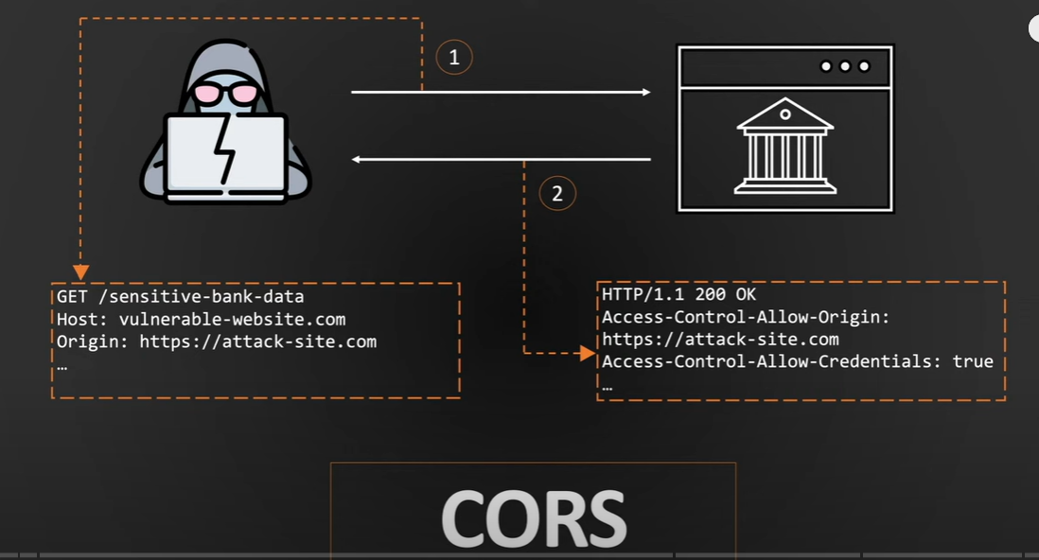
CORS Security Scanner: Detecting Misconfigurations in Web APIs
ROLL NO:AP22110011279
NAME:S.RAHUL
BRANCH&SEC:CSE-y

Slide 2
Introduction
What is CORS?
Browser security feature to manage cross-origin requests.
Relies on headers:
Access-Control-Allow-Origin
Access-Control-Allow-Credentials
Why it matters?
Misconfigurations expose APIs to Data Theft(OWASP TOP 10)

Slide 3
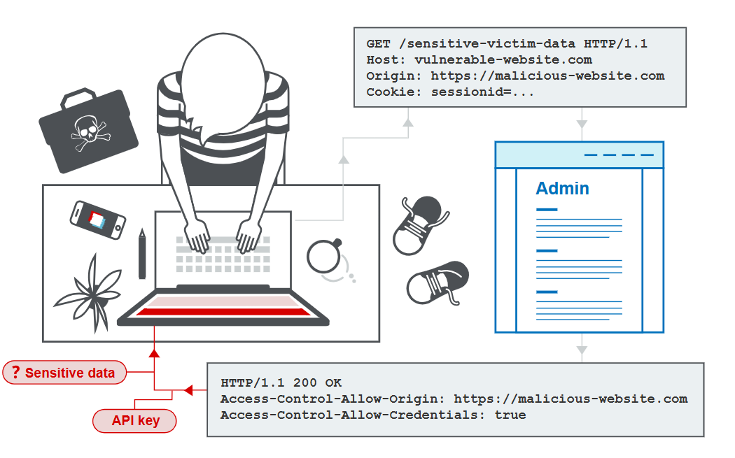
Attack Scenario
How hackers Exploit CORS

Slide 4
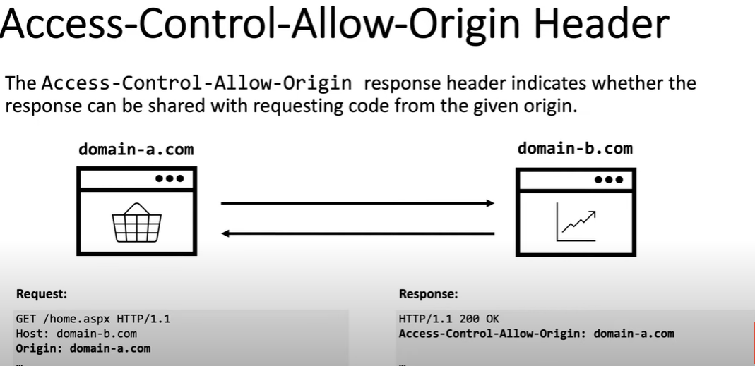
CORS Headers

Slide 5
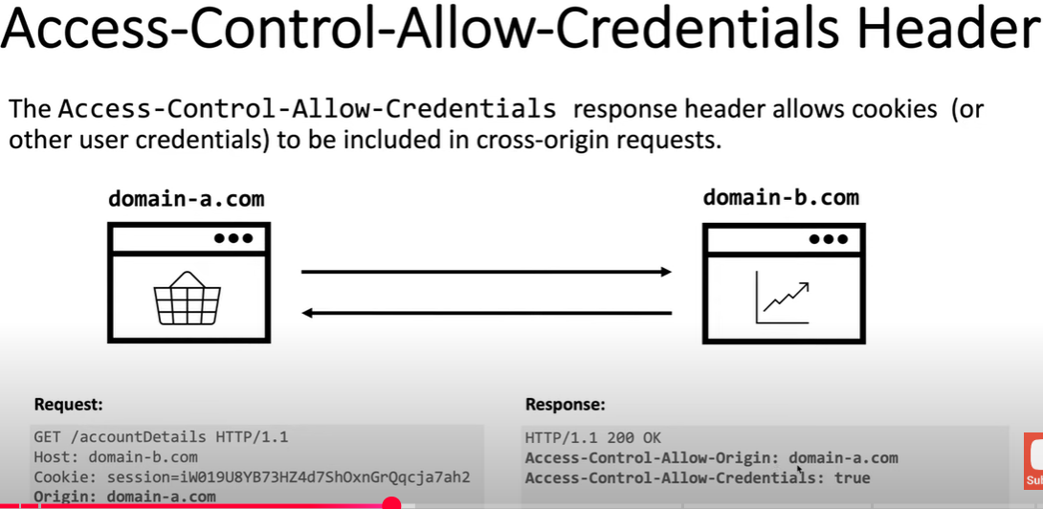
Project Objective

Slide 6
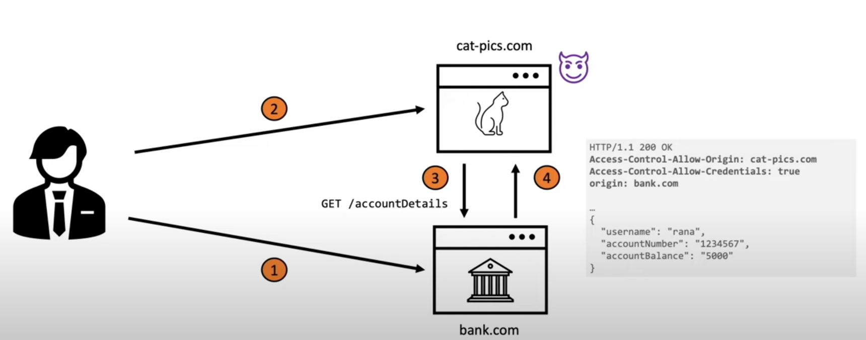
How hackers exploit
1.User logged into bank application.
2.In another tab the user opened malicious site.
3.cat.pics.com sends request to access the banking details.
4.And bank will reveal the your bank details

Slide 7
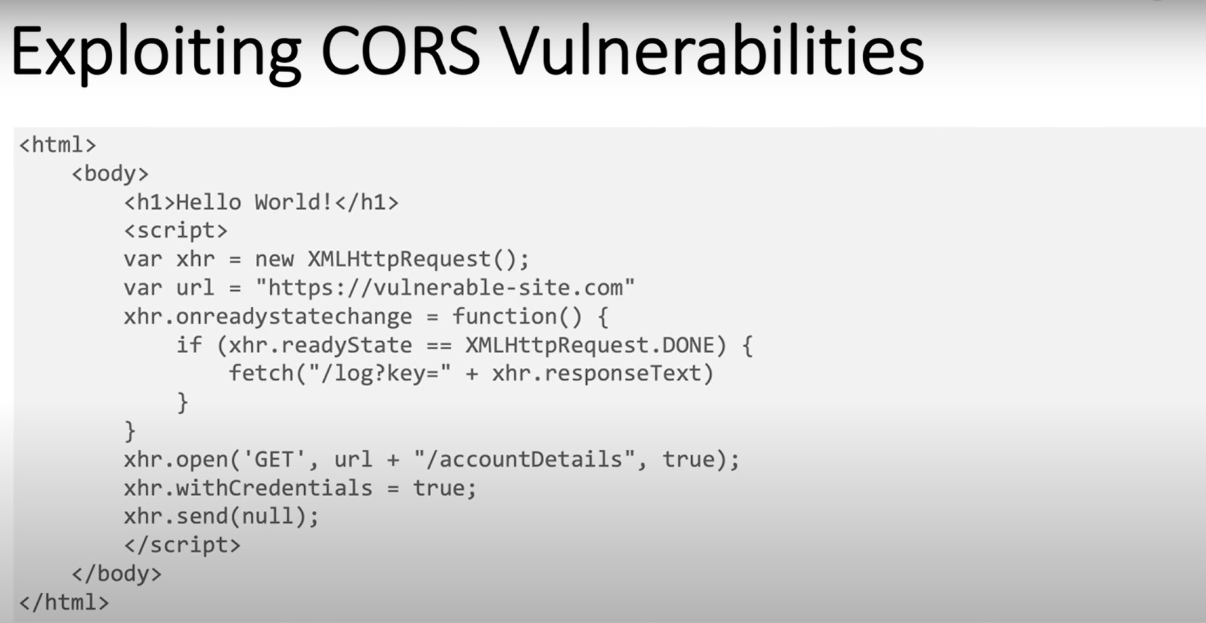
Cors vulenarability sample code

Slide 8
Prevention & Mitigation
Avoid wildcard(*) origin with credentials
Use allowlists (specific domains only)
Do not expose sensitive methods unnecessarily
Validate origin properly on backend
Regular security reviews and header validation

Slide 9
Conclusion
CORS misconfigurations are often overlooked
This tool helps identify risky configurations quickly
Can be integrated into CI/CD or used by security auditors
Future improvements: automated domain discovery, GUI, integration with vulnerability scanners

